Slide 1
Programming Language II CSE-215
Prof. Dr. Mohammad Abu Yousuf
yousuf@juniv.edu

Slide 2
Java String

Slide 3
In Java, string is basically an object that represents sequence of char values. An array of characters works same as Java string. For example:
char[] ch={'j','a','v','a','t','p','o','i','n','t'};
String s=new String(ch);
is same as:
String s="javatpoint";

Slide 4
Java String class provides a lot of methods to perform operations on string such as compare(), concat(), equals(), split(), length(), replace(), compareTo(), intern(), substring() etc.
How to create a string object?
There are two ways to create String object:
By string literal
By new keyword

Slide 5
1) String Literal
Java String literal is created by using double quotes. For Example:
String s="welcome";
Each time you create a string literal, the JVM checks the "string constant pool" first. If the string already exists in the pool, a reference to the pooled instance is returned. If the string doesn't exist in the pool, a new string instance is created and placed in the pool. For example:

Slide 6
2) By new keyword
String s=new String("Welcome");
In such case, JVM will create a new string object in normal (non-pool) heap memory, and the literal "Welcome" will be placed in the string constant pool. The variable s will refer to the object in a heap (non-pool).

Slide 7
Java String Example
public class StringExample{
public static void main(String args[]){
String s1="java";//creating string by java string literal
char ch[]={'s','t','r','i','n','g','s'};
String s2=new String(ch);//converting char array to string
String s3=new String("example");//creating java string by new keyword
System.out.println(s1);
System.out.println(s2);
System.out.println(s3);
}}
Output:
java
strings example

Slide 8
Java String class methods
The java.lang.String class provides many useful methods to perform operations on sequence of char values.

Slide 9
Immutable String in Java
In java, string objects are immutable. Immutable simply means unmodifiable or unchangeable.
Once string object is created its data or state can't be changed but a new string object is created.
class Testimmutablestring{
public static void main(String args[]){
String s=“Saif";
s.concat(" Shams");//concat() method appends the string at the end
System.out.println(s);//will print Saif because strings are immutable objects
}
}
Output: Saif

Slide 10
Immutable String in Java
if we explicitly assign it to the reference variable, it will refer to "Saif Shams" object. For example:
class Testimmutablestring1{
public static void main(String args[]){
String s="Saif";
s=s.concat(" Shams");
System.out.println(s);
}
}
Output: Saif Shams

Slide 11
Java String compare
We can compare string in java on the basis of content and reference.
It is used in authentication (by equals() method), sorting (by compareTo() method), reference matching (by == operator) etc.
There are three ways to compare string in java:
By equals() method
By = = operator
By compareTo() method

Slide 12
1) String compare by equals() method
The String equals() method compares the original content of the string. It compares values of string for equality. String class provides two methods:
public boolean equals(Object another) compares this string to the specified object.
public boolean equalsIgnoreCase(String another) compares this String to another string, ignoring case.

Slide 13
1) String compare by equals() method
class Teststringcomparison1{
public static void main(String args[]){
String s1="Sachin";
String s2="Sachin";
String s3=new String("Sachin");
String s4="Saurav";
System.out.println(s1.equals(s2));//true
System.out.println(s1.equals(s3));//true
System.out.println(s1.equals(s4));//false
}
}
Output: true
true
false

Slide 14
1) String compare by equals() method
class Teststringcomparison2{
public static void main(String args[]){
String s1="Sachin";
String s2="SACHIN";
System.out.println(s1.equals(s2));//false
System.out.println(s1.equalsIgnoreCase(s2));//true
}
}
Output:
false
true

Slide 15
2) String compare by == operator
The = = operator compares references not values.
class Teststringcomparison3{
public static void main(String args[]){
String s1="Sachin";
String s2="Sachin";
String s3=new String("Sachin");
System.out.println(s1==s2);//true (because both refer to same instance)
System.out.println(s1==s3);//false(because s3 refers to instance created in nonpool)
}
}
Output: true
false

Slide 16
3) String compare by compareTo() method
The String compareTo() method compares values lexicographically and returns an integer value that describes if first string is less than, equal to or greater than second string.
Suppose s1 and s2 are two string variables. If:
s1 == s2 :0
s1 > s2 :positive value
s1 < s2 :negative value

Slide 17
3) String compare by compareTo() method
class Teststringcomparison4{
public static void main(String args[]){
String s1="Sachin";
String s2="Sachin";
String s3="Ratan";
System.out.println(s1.compareTo(s2));//0
System.out.println(s1.compareTo(s3));//1(because s1>s3)
System.out.println(s3.compareTo(s1));//-1 (because s3 < s1 )
}
}
Output: 0
1
-1

Slide 18
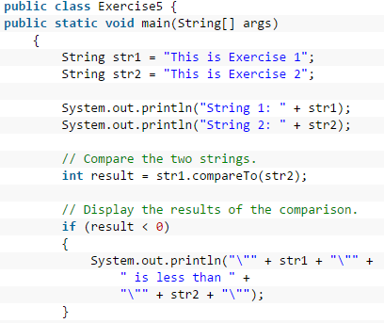

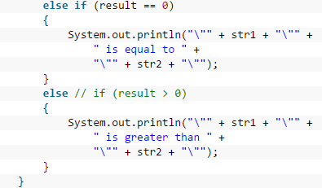
Write a java program to compare two strings lexicographically.

Slide 19
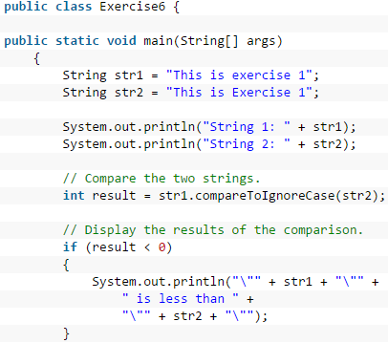
String 1: This is exercise 1
String 2: This is Exercise 1
"This is exercise 1" is equal to "This is Exercise 1"

Slide 20
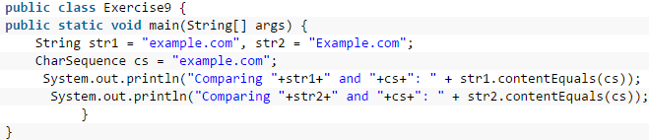

Write a Java program to compare a given string to the specified character sequence.

Slide 21
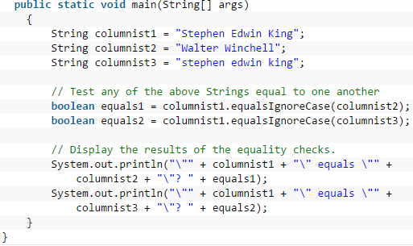


Slide 22
String Concatenation in Java
In java, string concatenation forms a new string that is the combination of multiple strings. There are two ways to concat string in java:
By + (string concatenation) operator
By concat() method

Slide 23
2) String Concatenation by concat() method
class TestStringConcatenation3{
public static void main(String args[]){
String s1="Sachin ";
String s2="Tendulkar";
String s3=s1.concat(s2);
System.out.println(s3);//Sachin Tendulkar
}
}

Slide 24
Substring in Java
A part of string is called substring. In other words, substring is a subset of another string. In case of substring startIndex is inclusive and endIndex is exclusive.
We can get substring from the given string object by one of the two methods:
public String substring(int startIndex): This method returns new String object containing the substring of the given string from specified startIndex (inclusive).
public String substring(int startIndex, int endIndex): This method returns new String object containing the substring of the given string from specified startIndex to endIndex.

Slide 25
Substring in Java
String s="hello";
System.out.println(s.substring(0,2));//he
In the above substring, 0 points to h but 2 points to e (because end index is exclusive).
public class TestSubstring{
public static void main(String args[]){
String s="SachinTendulkar";
System.out.println(s.substring(6));//Tendulkar
System.out.println(s.substring(0,6));//Sachin
}
}

Slide 26
Java String charAt()
The java string charAt() method returns a char value at the given index number.
The index number starts from 0 and goes to n-1, where n is length of the string. It returns StringIndexOutOfBoundsException if given index number is greater than or equal to this string length or a negative number.

Slide 27
Java String charAt() Example 1
public class CharAtExample{
public static void main(String args[]){
String name="javatpoint";
char ch=name.charAt(4);//returns the char value at the 4th index
System.out.println(ch);
}}
Output: t

Slide 28
Java String charAt() Example 2
public class CharAtExample3 {
public static void main(String[] args) {
String str = "Welcome to Javatpoint portal";
int strLength = str.length();
// Fetching first character
System.out.println("Character at 0 index is: "+ str.charAt(0));
// The last Character is present at the string length-1 index
System.out.println("Character at last index is: "+ str.charAt(strLength-1));
}
}
Output:
Character at 0 index is: W
Character at last index is: l

Slide 29
Java String charAt() Example 3
public class CharAtExample5 {
public static void main(String[] args) {
String str = "Welcome to Javatpoint portal";
int count = 0;
for (int i=0; i<=str.length()-1; i++) {
if(str.charAt(i) == 't') {
count++;
}
}
System.out.println("Frequency of t is: "+count);
}
}
Output:
Frequency of t is: 4

Slide 30
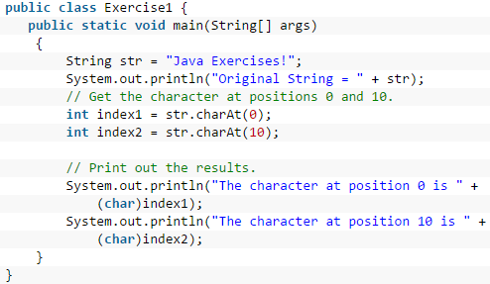

Write a Java program to get the character at the given index within the String.

Slide 31
Thank you

